Slide 1
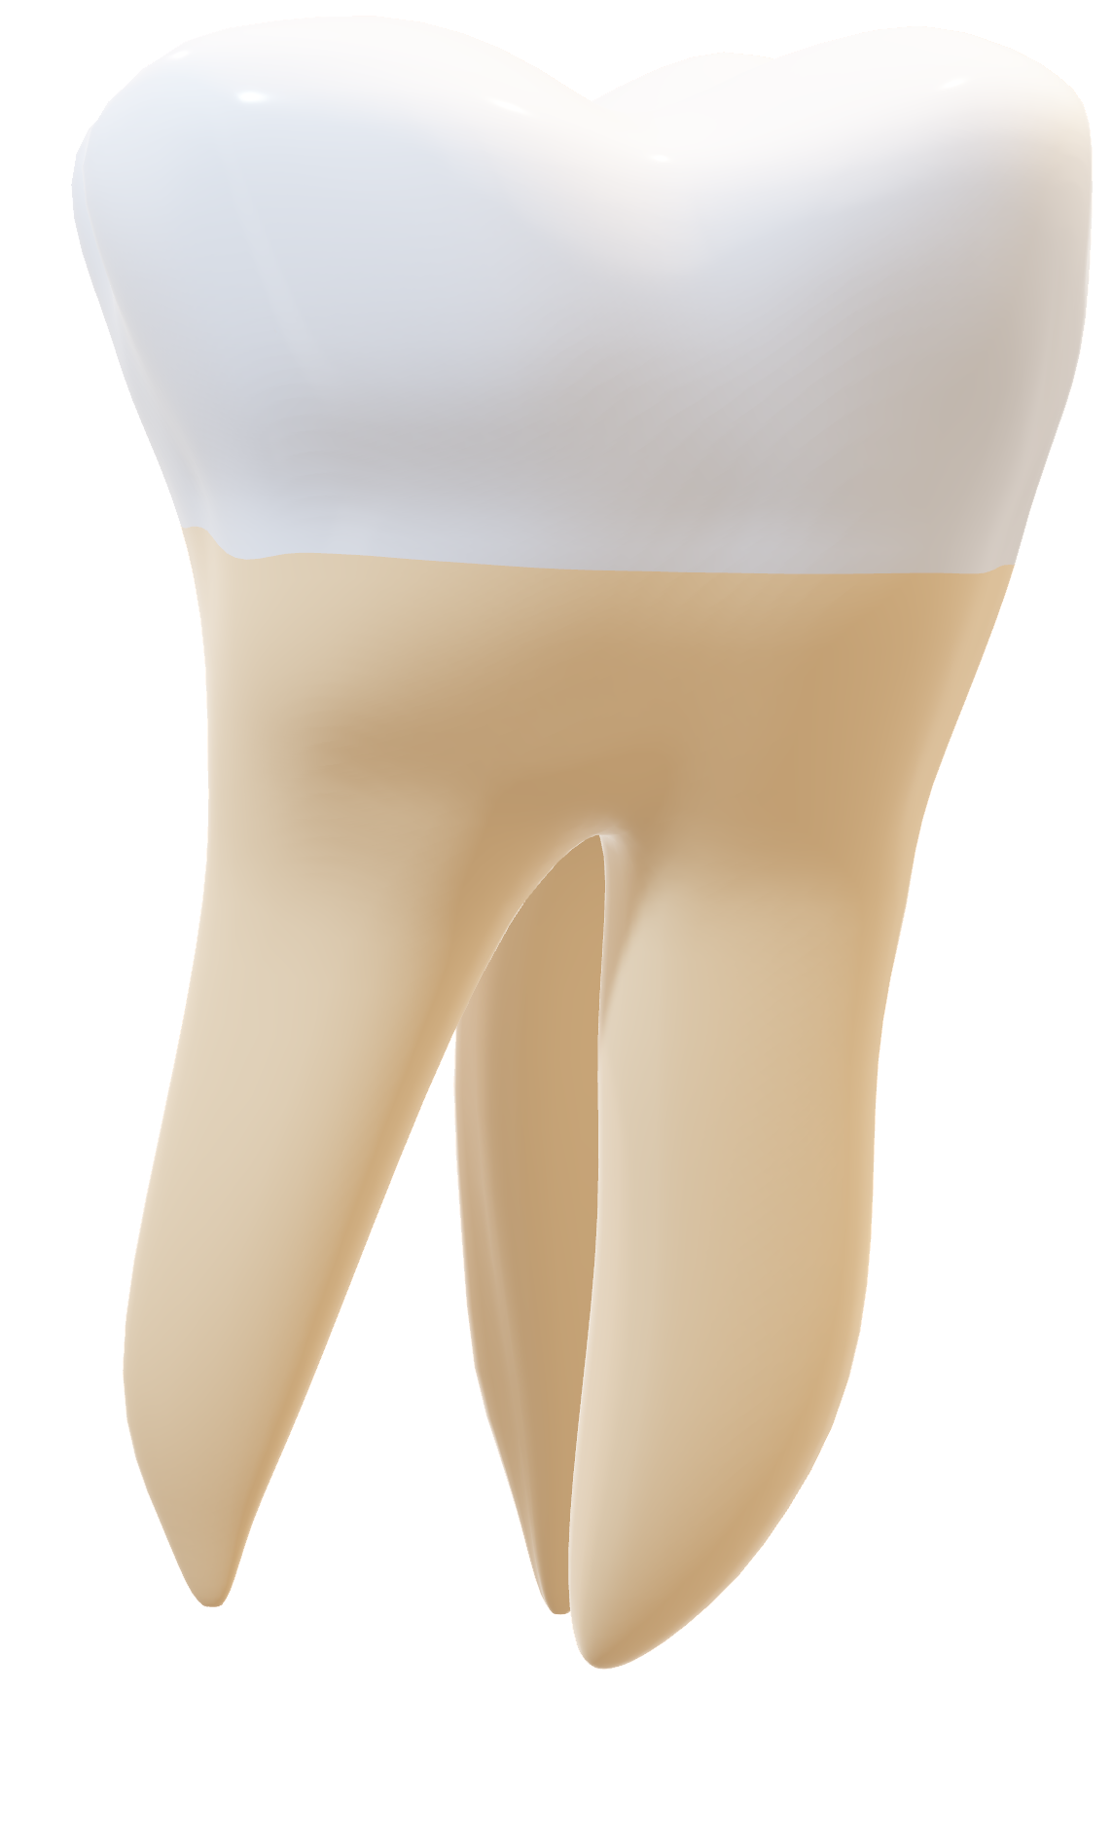
Thoutha
Let’s connect people

Slide 2
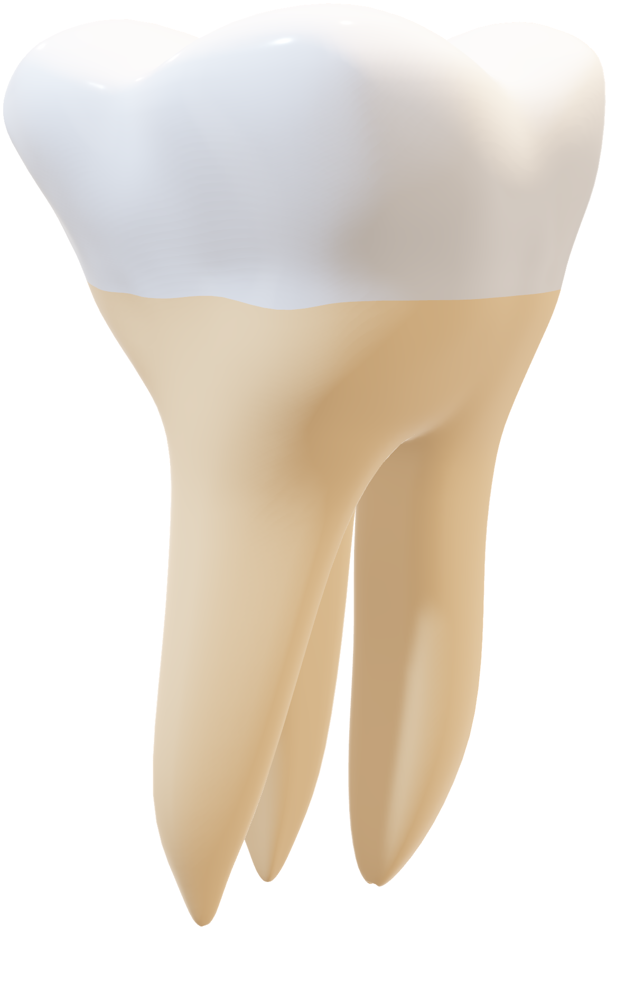
Worked and presented to you by:
Joesph George Wahba
Zeyad Saad Abdel-Fattah
Muhammed Ashraf El-Kateb
Zyad Gamal Saeed
Menna-Allah Ahmed
Abdelhalim Ramadan
Zeyad Muhamed Yehya

Slide 3
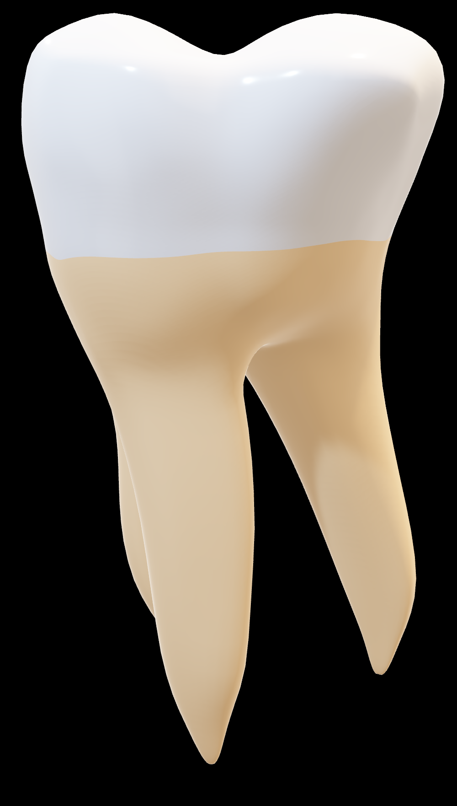
Executive Summary:
About the Project
Aims to design and develop a digital platform (mobile & web application) that connects Dental Students with Patients who need affordable dental care.
The system will serve as a mutual benefit bridge:
Patients: gain access to low-cost or free dental services, while maintaining trust through faculty supervision.
Students: gain valuable hands-on experience by working on real cases, supported by structured scheduling, patient feedback, and digital case tracking

Slide 4
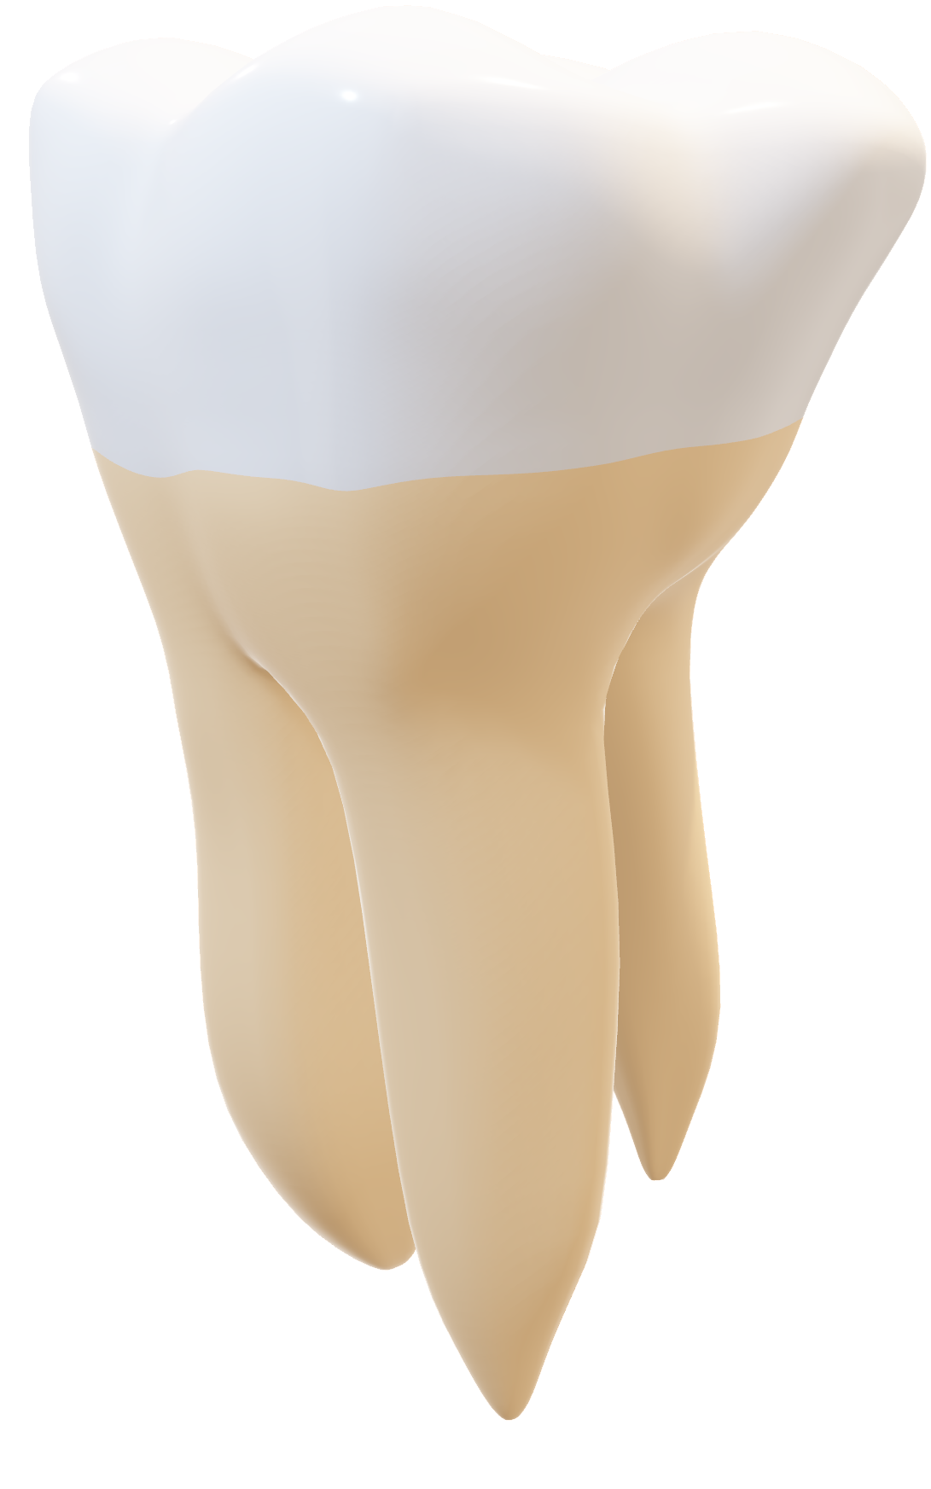
Key Objectives:
Provide accessible and affordable dental services for patients.
Enable students to practice, learn, and improve skills before graduation.
Ensure secure, easy, and professional communication between both parties.
Collect feedback and generate insights to improve healthcare quality.
Why It Matters?
Tackles the challenge of limited patient access to affordable dental care.
Empowers students with practical exposure under supervision.
Bridges the gap between academia and real-world practice.
Supports the college’s mission in community service & innovation.

Slide 5
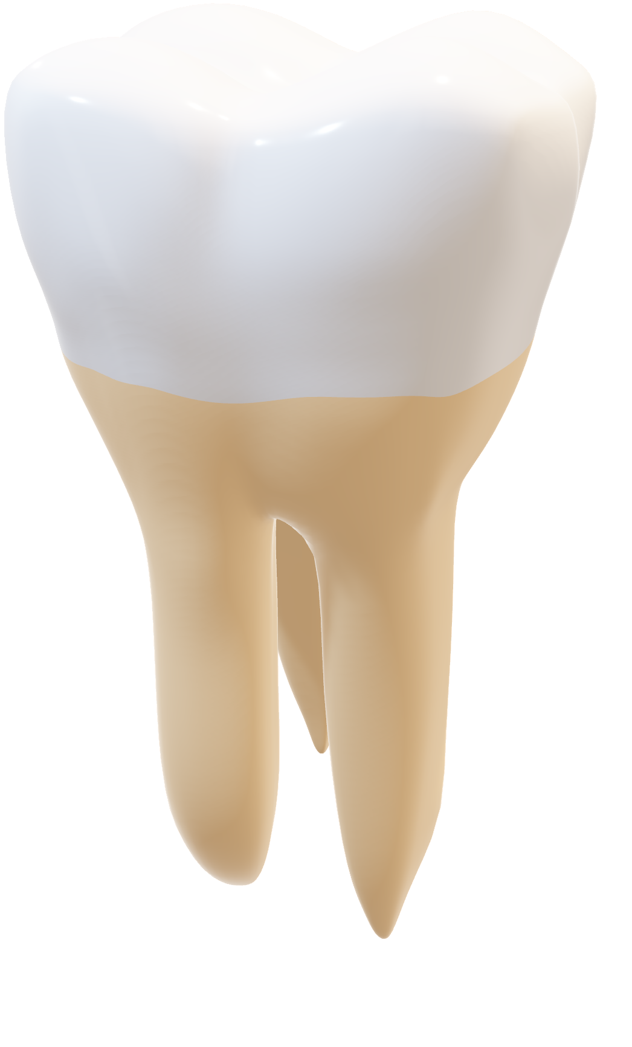
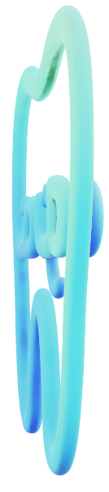
But what do people think about the idea?
We found that Egypt has around 81 dental colleges in total.
Among them, 22 belong to public (governmental) universities, 37 belong to private universities, and 22 belong to national (non-profit) universities.
Every year, around 70,000 undergraduate students study dentistry across these colleges.
As the survey that’s made from our team on Google Forms, we got 92 till now!
And to solve the past problems we came up with…

Slide 6
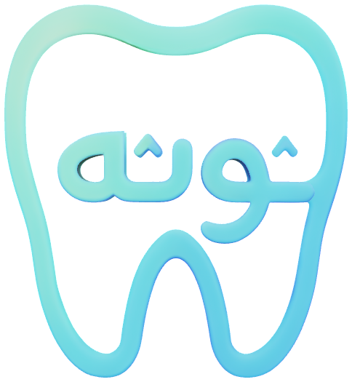
Thoutha

Slide 7

Thoutha
🦷 Bridging the Gap in Egyptian Dental Education and Care
The Solution: A Digital Bridge
DENTAL CASE CONNECTION SYSTEM (DCCS) (Mobile App + Web Platform)
How It Works
Patient Input: Patient describes symptoms.
AI Chatbot: Performs a preliminary diagnosis and categorizes the case (e.g., Root Canal, Cavity).
Matching: System pairs the patient with a student needing that specific training case.
Key System Guarantee:
All interactions are securely monitored via an Admin Dashboard for ethical use and privacy compliance.

Slide 8
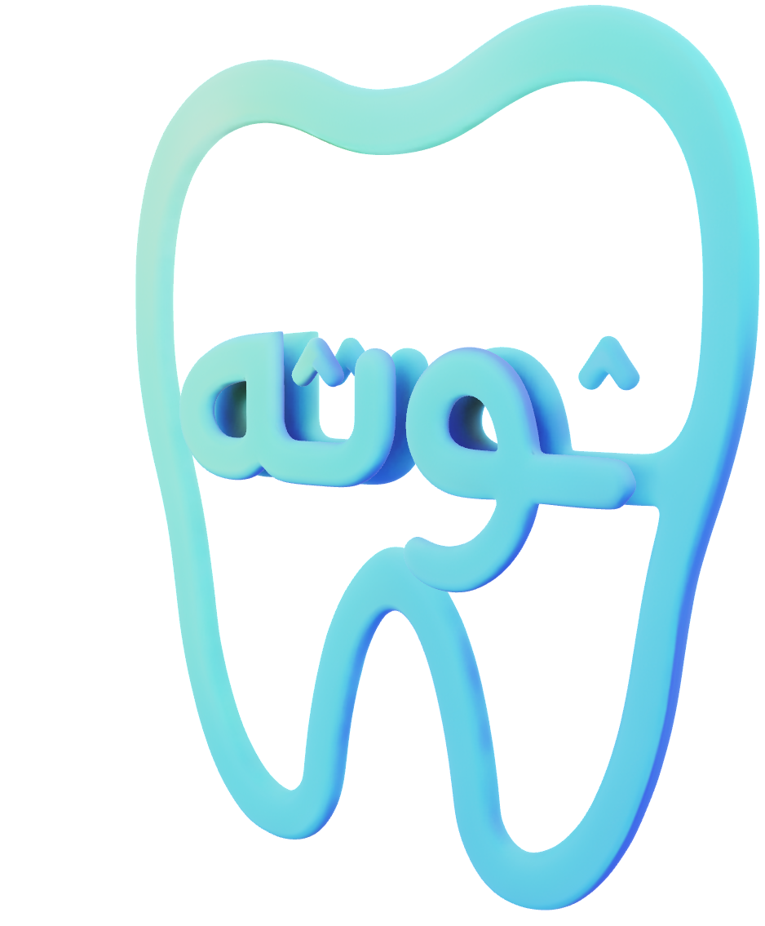
Thoutha

Slide 9
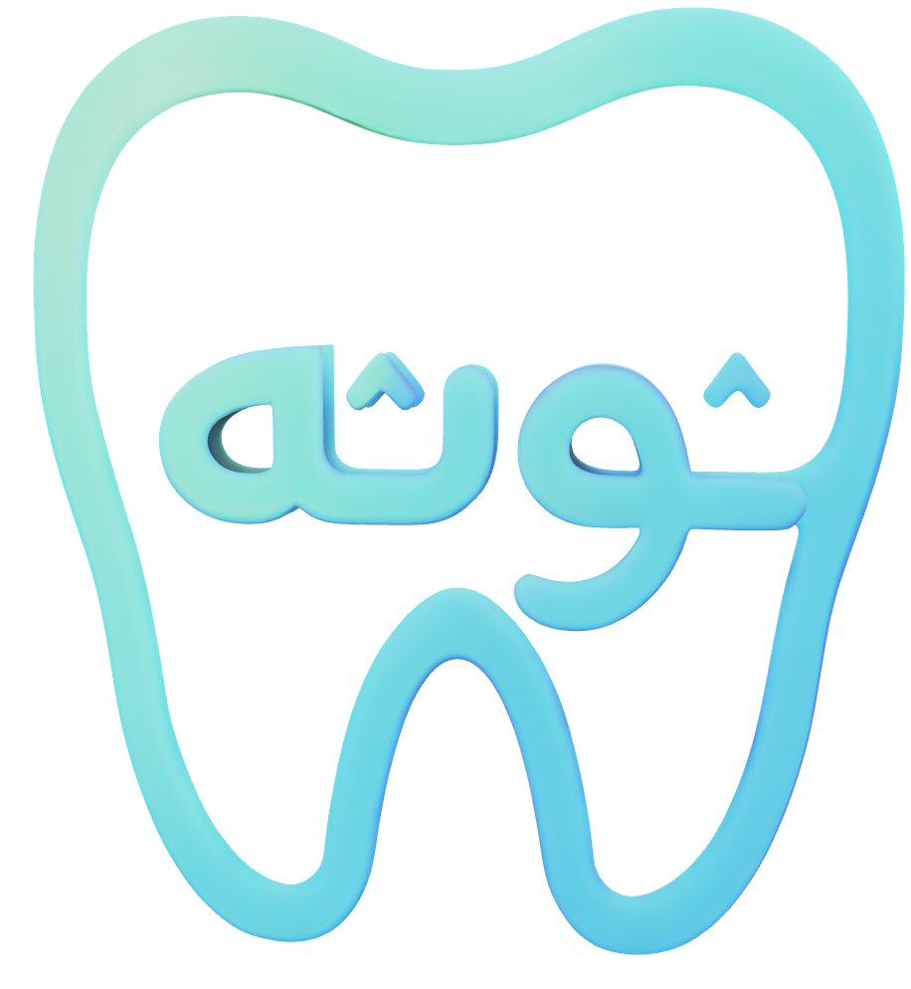
Thotha

Slide 10
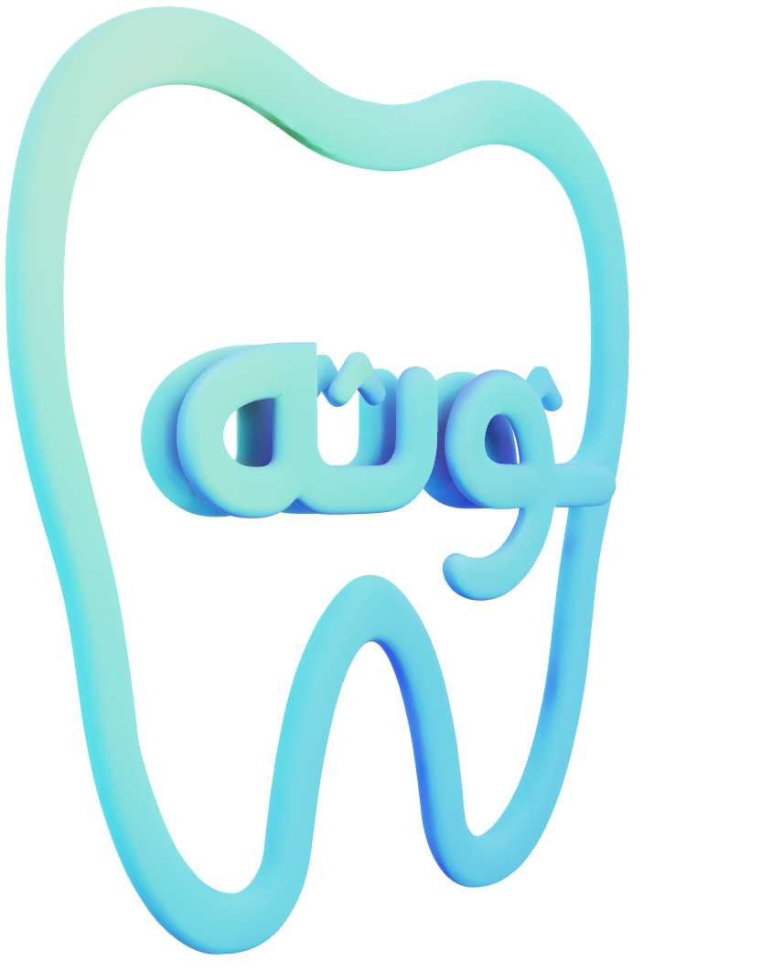
Thotha

Slide 11

Thotha

Slide 12
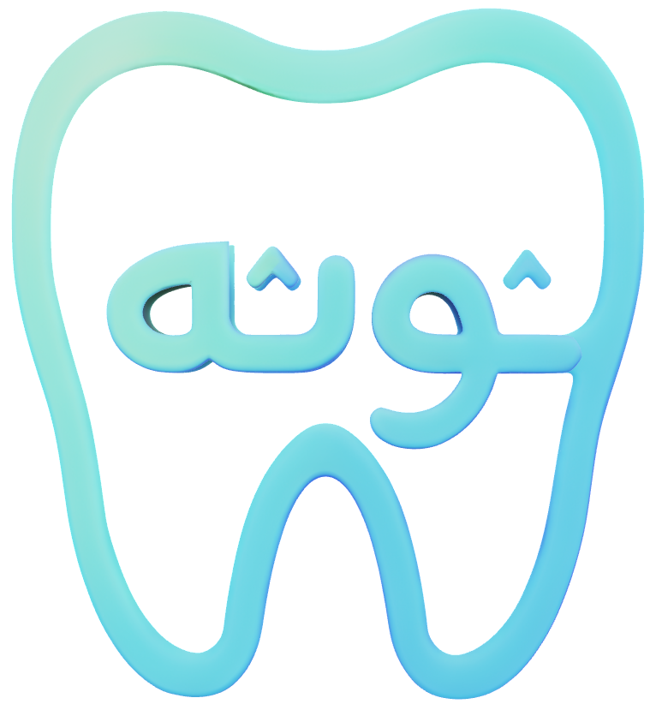
Thotha

Slide 13
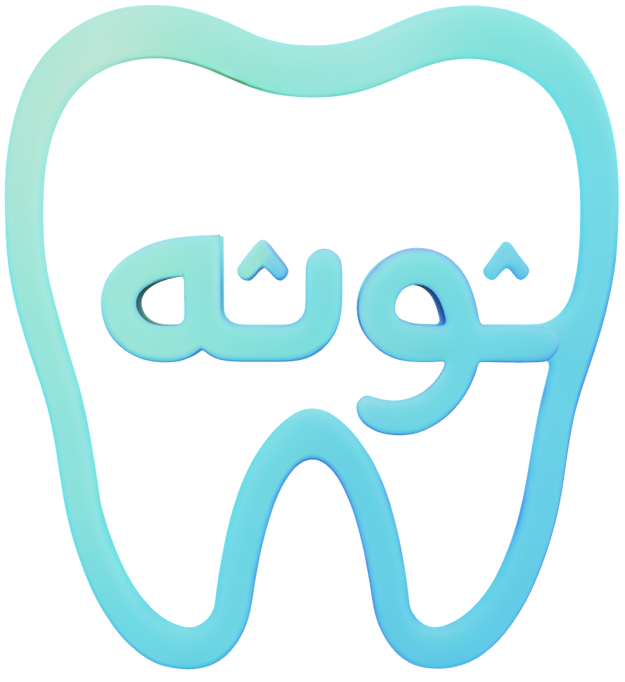
Thotha

Slide 14
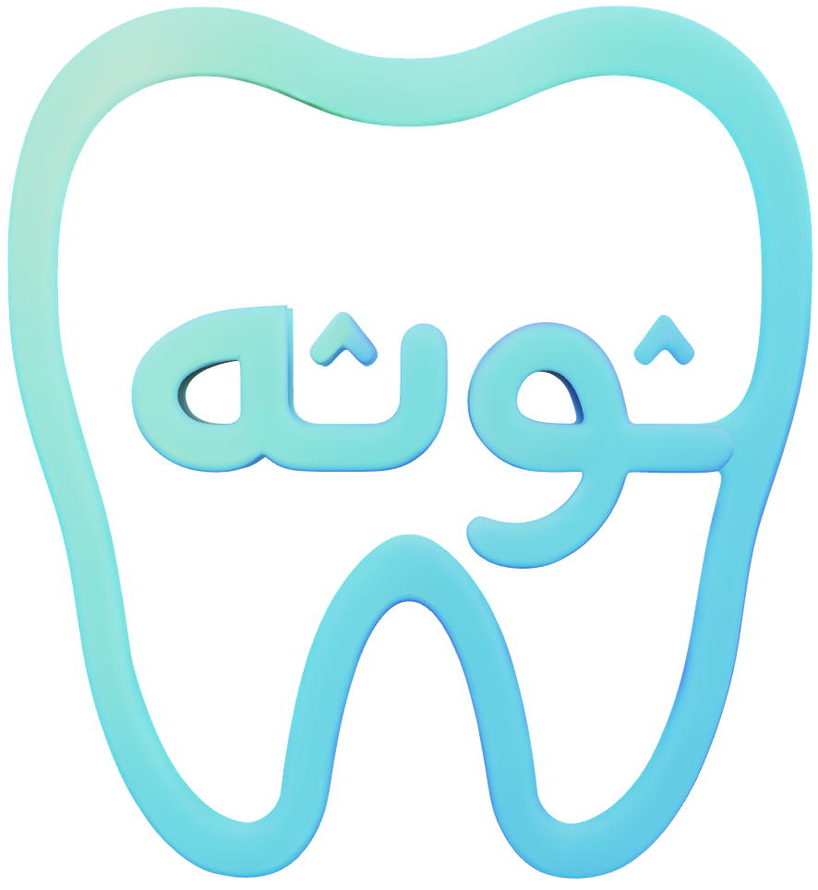
Thotha

Slide 15

Thotha

